Slide 1
Engaging Teens
With Your Library
2018 Workshop resources available at http://leonline.com/engaging-teens-with-your-library/

Slide 2
The workshop description:
There is a shift in the ways in which library staff work with and for teens which includes a focus on: relationship building facilitation of learning, impact and outcomes, and community engagement. In this session you will review and re-envision the world of library teen services. These are services with the goal of helping teens develop the skills, knowledge, and social emotional development needed for success in life. At the end of the session you will have tools and knowledge for a revitalized approach to teen services and be able to begin integrating new and expanded ideas in your community right away.
Today We’ll Talk About

Slide 3
Welcome & Introductions
Starting with Impact
Challenging Ideas
Who are Teens 2018
The Paradigm Shift in Library Services
Making it Work in Your Setting
Agenda
Big Ideas

Slide 4
Reaching Outcomes

Slide 5
Learning from Each Other - Library Impact
Stand up!
Consider these two questions: What impact do you and your library want to have when it comes to supporting teens in your community? How can you achieve that impact?
Find a person you don’t know and discuss your answers to these questions.
We’ll switch pairs in 3 minutes and do this switching 2 times.

Slide 6
What Did You Notice/Learn
On a post-it write:
What you noticed were similarities and differences in the conversations you just had.
What ideas have you already come up with from those short conversations?
What questions do you now have?
Put your post-its on the designated chart paper.

Slide 7
Outcomes Based Assessment
The impacts/benefits/changes for participants during or after your program. These changes, or outcomes, are usually expressed in terms of changes to:
1) knowledge and skills.
2) behaviors.
3) values, conditions, and status.
Outcomes must be measurable and measurable within a reasonable period of time, or you have no way of knowing if your program has achieved them. For example, you might want to set an outcome of creating lifelong learners, but there’s no way to measure whether your participants end up becoming lifelong learners
Notes:
Who/what will be changed (individuals, families, organizations, community)?
What will change?
Why do these goals matter?

Slide 8
Sample Outcomes
Teens increase ability to collaborate with their peers.
Teens demonstrate increased enjoyment and interest in building, tinkering, and making.
Teens build strategies for solving problems
How Do You See Success
Looking at the above outcomes, what are some ways you think you would be able to collect information that would demonstrate success in reaching those outcomes?

Slide 9
Creating Your Own Outcomes
Thinking about the topics covered in this workshop so far - SEL, Youth Voice, Community Engagement - try writing an outcome for something related to one of those topics. Include:
The impact /change you want to have within the topic selected
How you will achieve that impact - what’s the activity to get there
What you will collect to know you’ve reached that impact

Slide 10
Select the idea that you are most curious about/interested in. Join the table labeled with that idea:
You do not have to be the expert
Risk is a good thing
Failure is OK
Learning from mistakes is required
Iteration is required
At your table brainstorm what you think the idea means within the context of teen library services. Write down three questions, thoughts, and/or examples.
Challenging Ideas

Slide 11
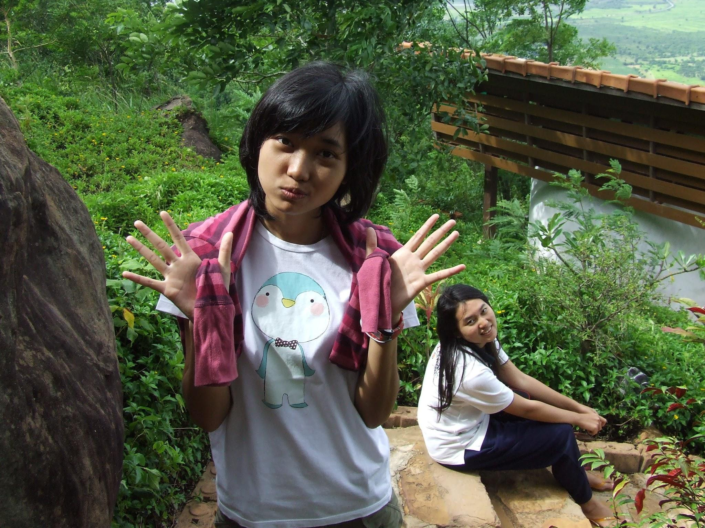
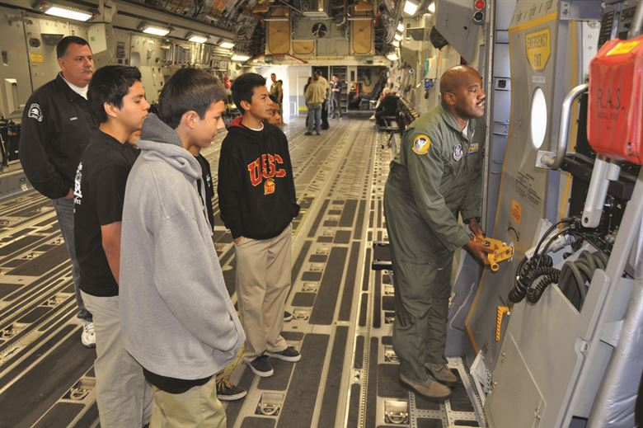
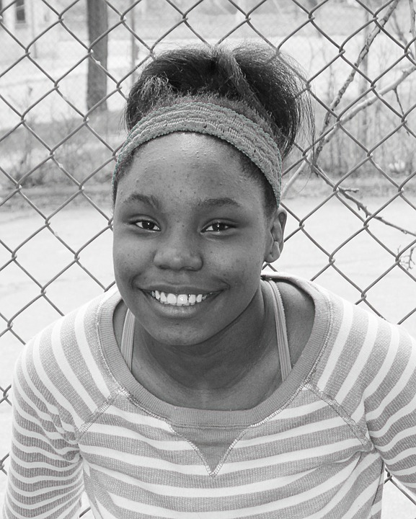
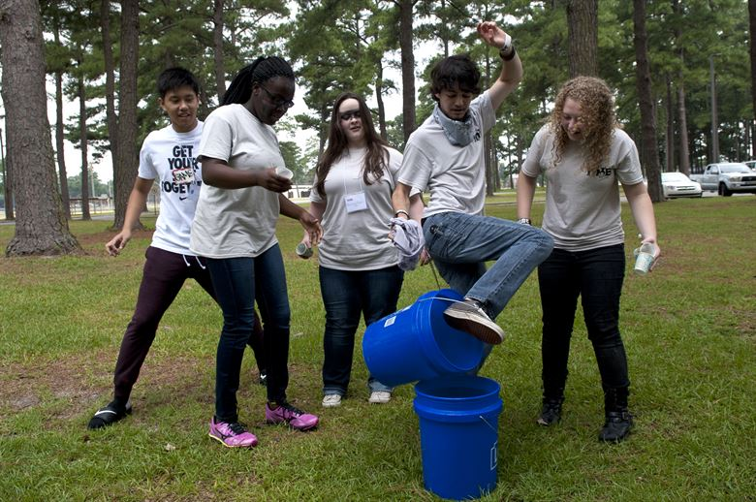
Who Are Teens 2018

Slide 12
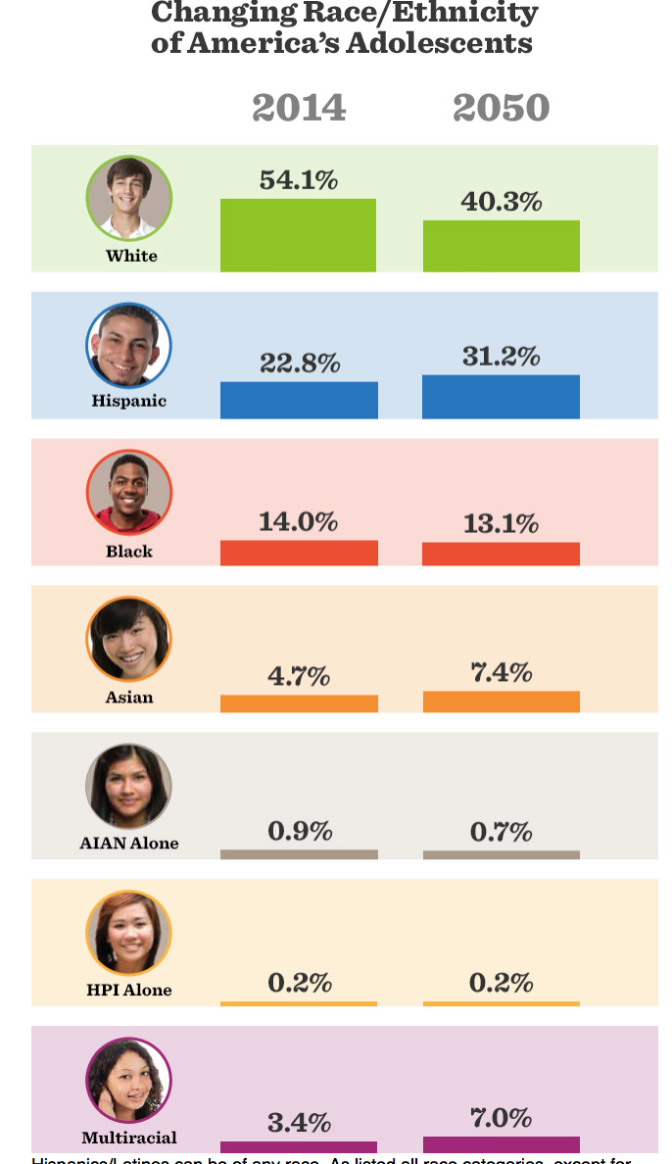
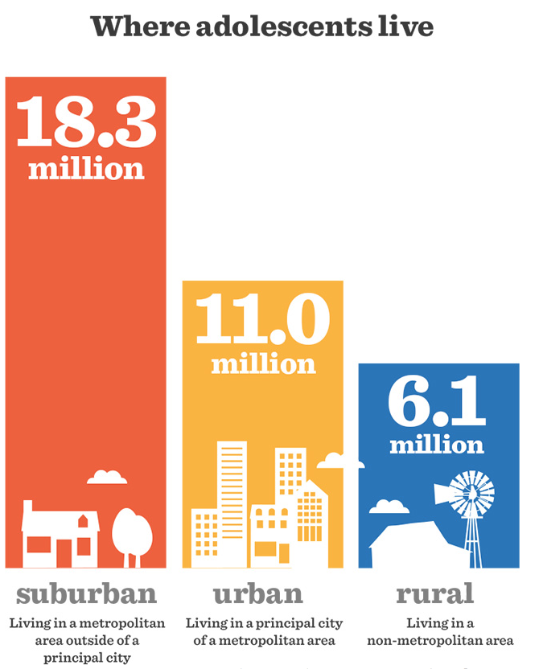
Teen Demographics National
Notes:
Source - https://www.hhs.gov/ash/oah/facts-and-stats/changing-face-of-americas-adolescents/index.html

Slide 13
“What’s become increasingly clear is that the dramatic changes in brain biology mean the teenage years are full of opportunity and vulnerability,...It’s a time of phenomenal leaps in our creativity and cognitive abilities...This seeming paradox of adolescence is not a coincidence. Both the leaps in ability and the vulnerabilities to illness are related to the human adolescent brain’s remarkable ability to change.”
Adolescent Development
Notes:
http://time.com/4929170/inside-teen-teenage-brain/

Slide 14
Adolescent Development Wonder Wall
In the next 3 minutes:
On post-its write down what you wonder about libraries, teens, and adolescent development - one idea per post-it
When post-its complete add to the sticky chart paper on the designated wall

Slide 16
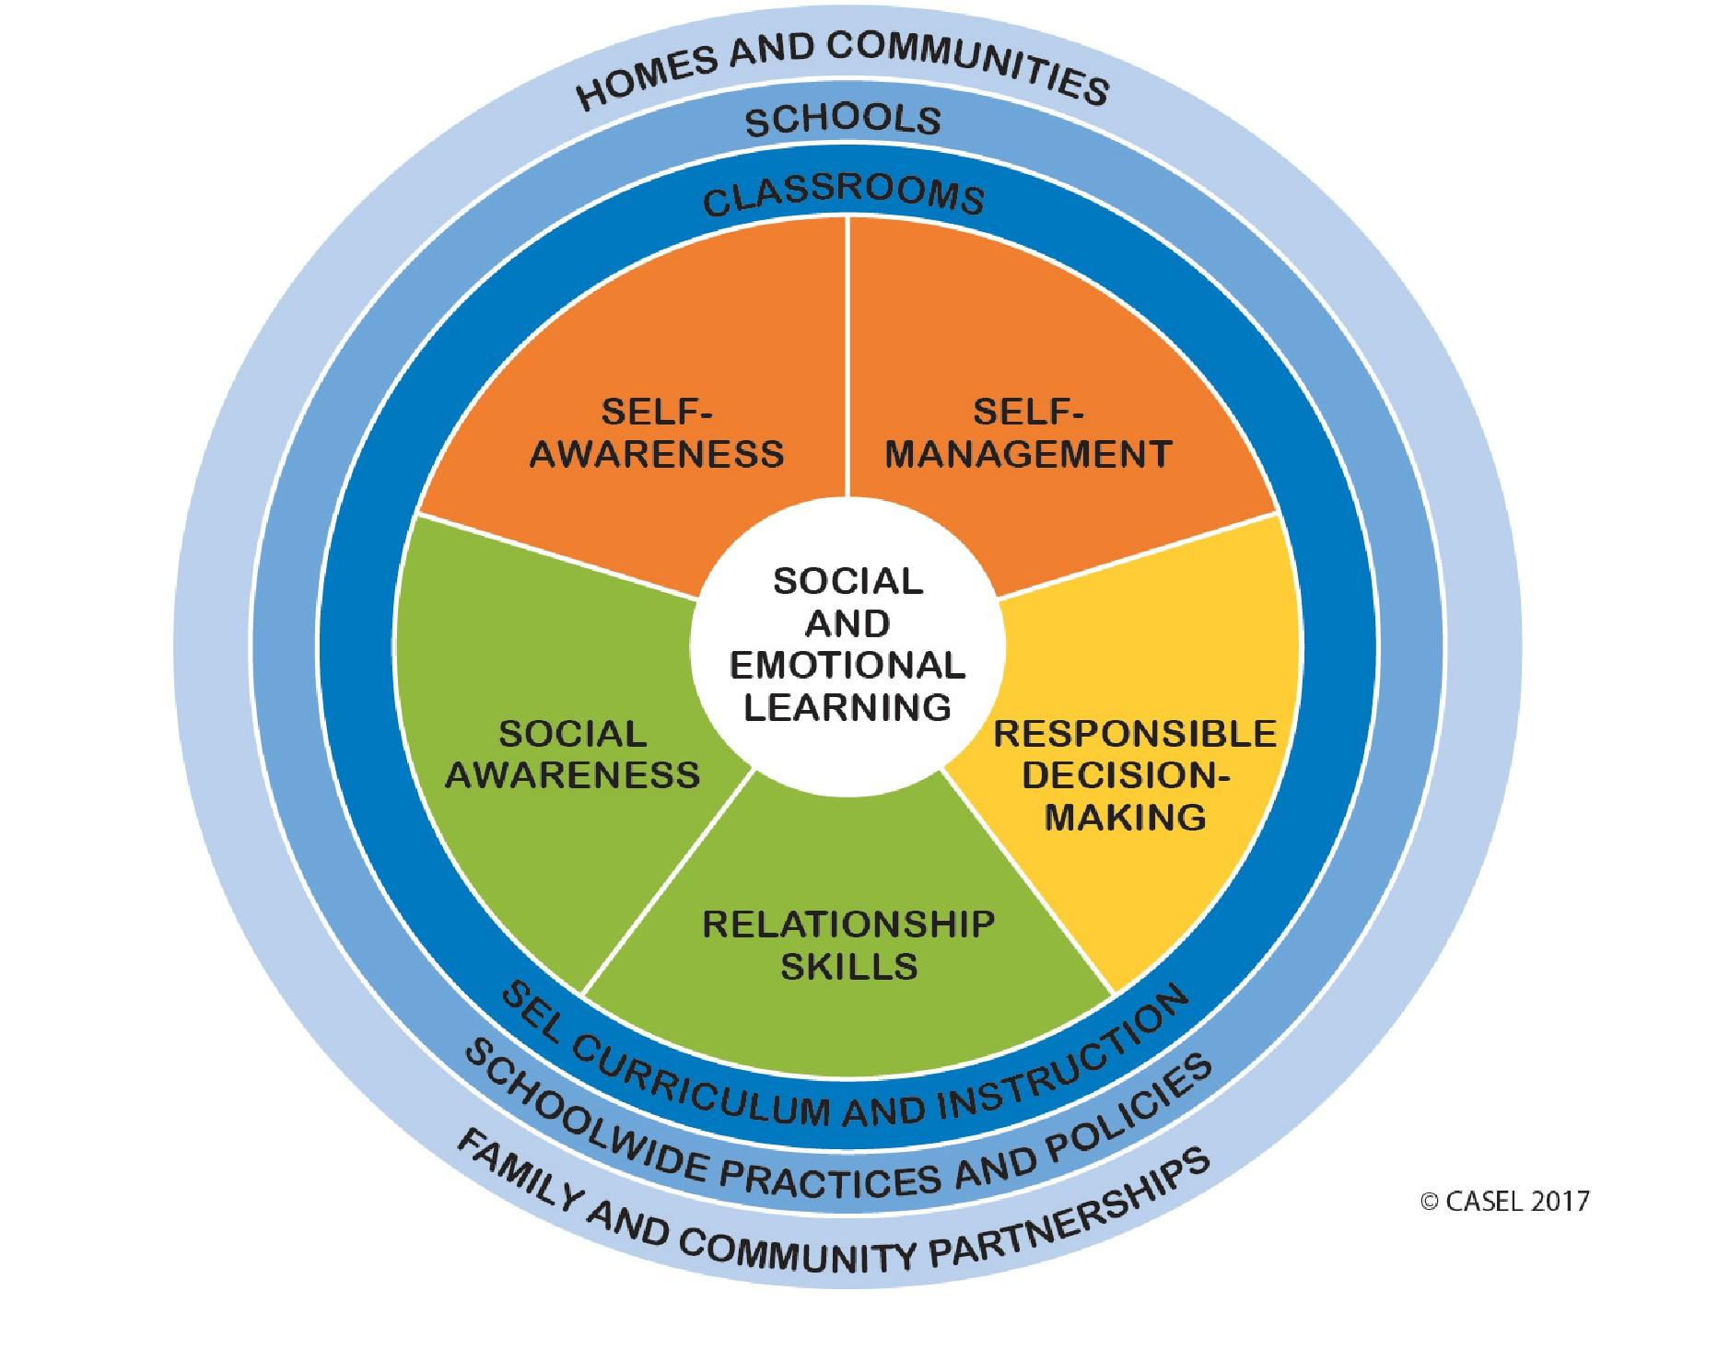
Notes:
https://casel.org/wp-content/uploads/2017/01/Competencies.pdf

Slide 17
SEL Snowballs
On a piece of paper write down one thing you can do to support SEL for/with teens.
Crush your paper into a ball
Stand up
Make a circle
Throw your ball
Pick up a ball
Volunteer to read it out loud

Slide 18
Break

Slide 19
As you watch the video write down the words and phrases that jump out at you in some way. Something that seems new or different for example.
Once the video is over post your words and phrases on the Connected Learning wall.

Slide 20
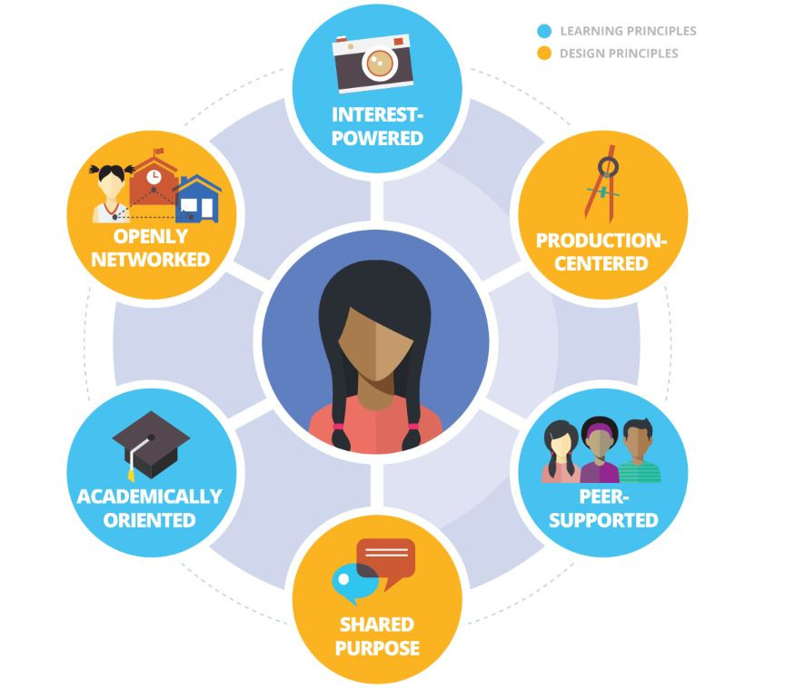

Slide 21
Lunch

Slide 22
Reflect
For the next 5 minutes use a technique that is best for your learning style to individually reflect on what’s been discussed so far. Sit and think, write down ideas, draw something, do what works for you.
Spend the second 5 minutes talking with your tablemates about the morning, what you’ve thought about, what was new, what was surprising, etc.
Come up with a list of three things based on what we’ve talked about so far today that you want to learn more about and/or start implementing quickly Give what you write down to Linda

Slide 24
Youth Voice
“Youth voice is broadly defined as ‘the perception that one’s opinions are heard and respected by others particularly adults.’ Sara Vogel is a research assistant and PhD student for Global Education at the Graduate Center of the City University of New York, who has many years of experience working as an educator. She explains how youth voice can be twofold:
(1) youth express their idea of the world, and; (2) youth express opinions on what and how they are learning. ‘The learning can take different forms: their opinions about things, their self-expression, their message to the world.’”
Notes:
Rubio, Putting Teens First

Slide 25
What is Community Engagement
“A process that includes multiple techniques to promote the participation of community members in community life, especially those who are excluded and isolated, to engage them in collective action to promote a healthy community.”
Notes:
https://static1.squarespace.com/static/54317469e4b056843fc6796c/t/55301634e4b0fbdc0bcb32e8/1429214772325/BTF-ImpactsofCEGraphic.pdf

Slide 26
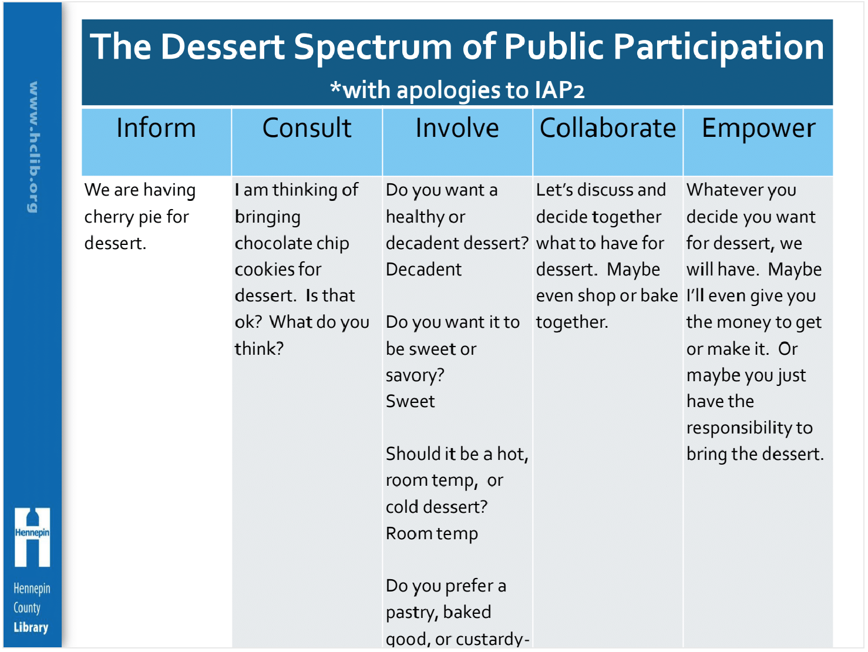
Engage with Community

Slide 27
Teen Centered /Youth Centered

Slide 28
Break

Slide 29
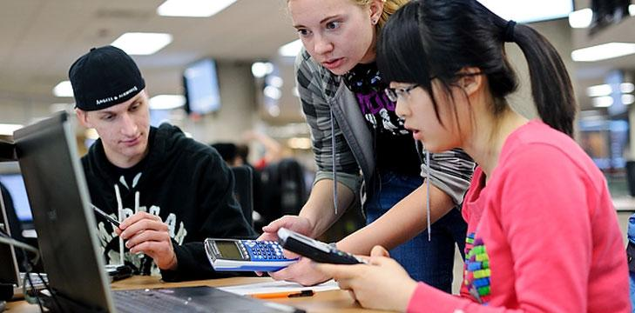
Facilitate Learning

Slide 30
Making it Work in Your Setting
Spend 10 minutes answering these 3 questions:
How do you learn about teen interests in the area in which you work?
How do you leverage the interests of teens and the needs of the community to design and deliver great services for and with teens?
How do you build relationships with local community members and organizations in order to support teens?

Slide 31
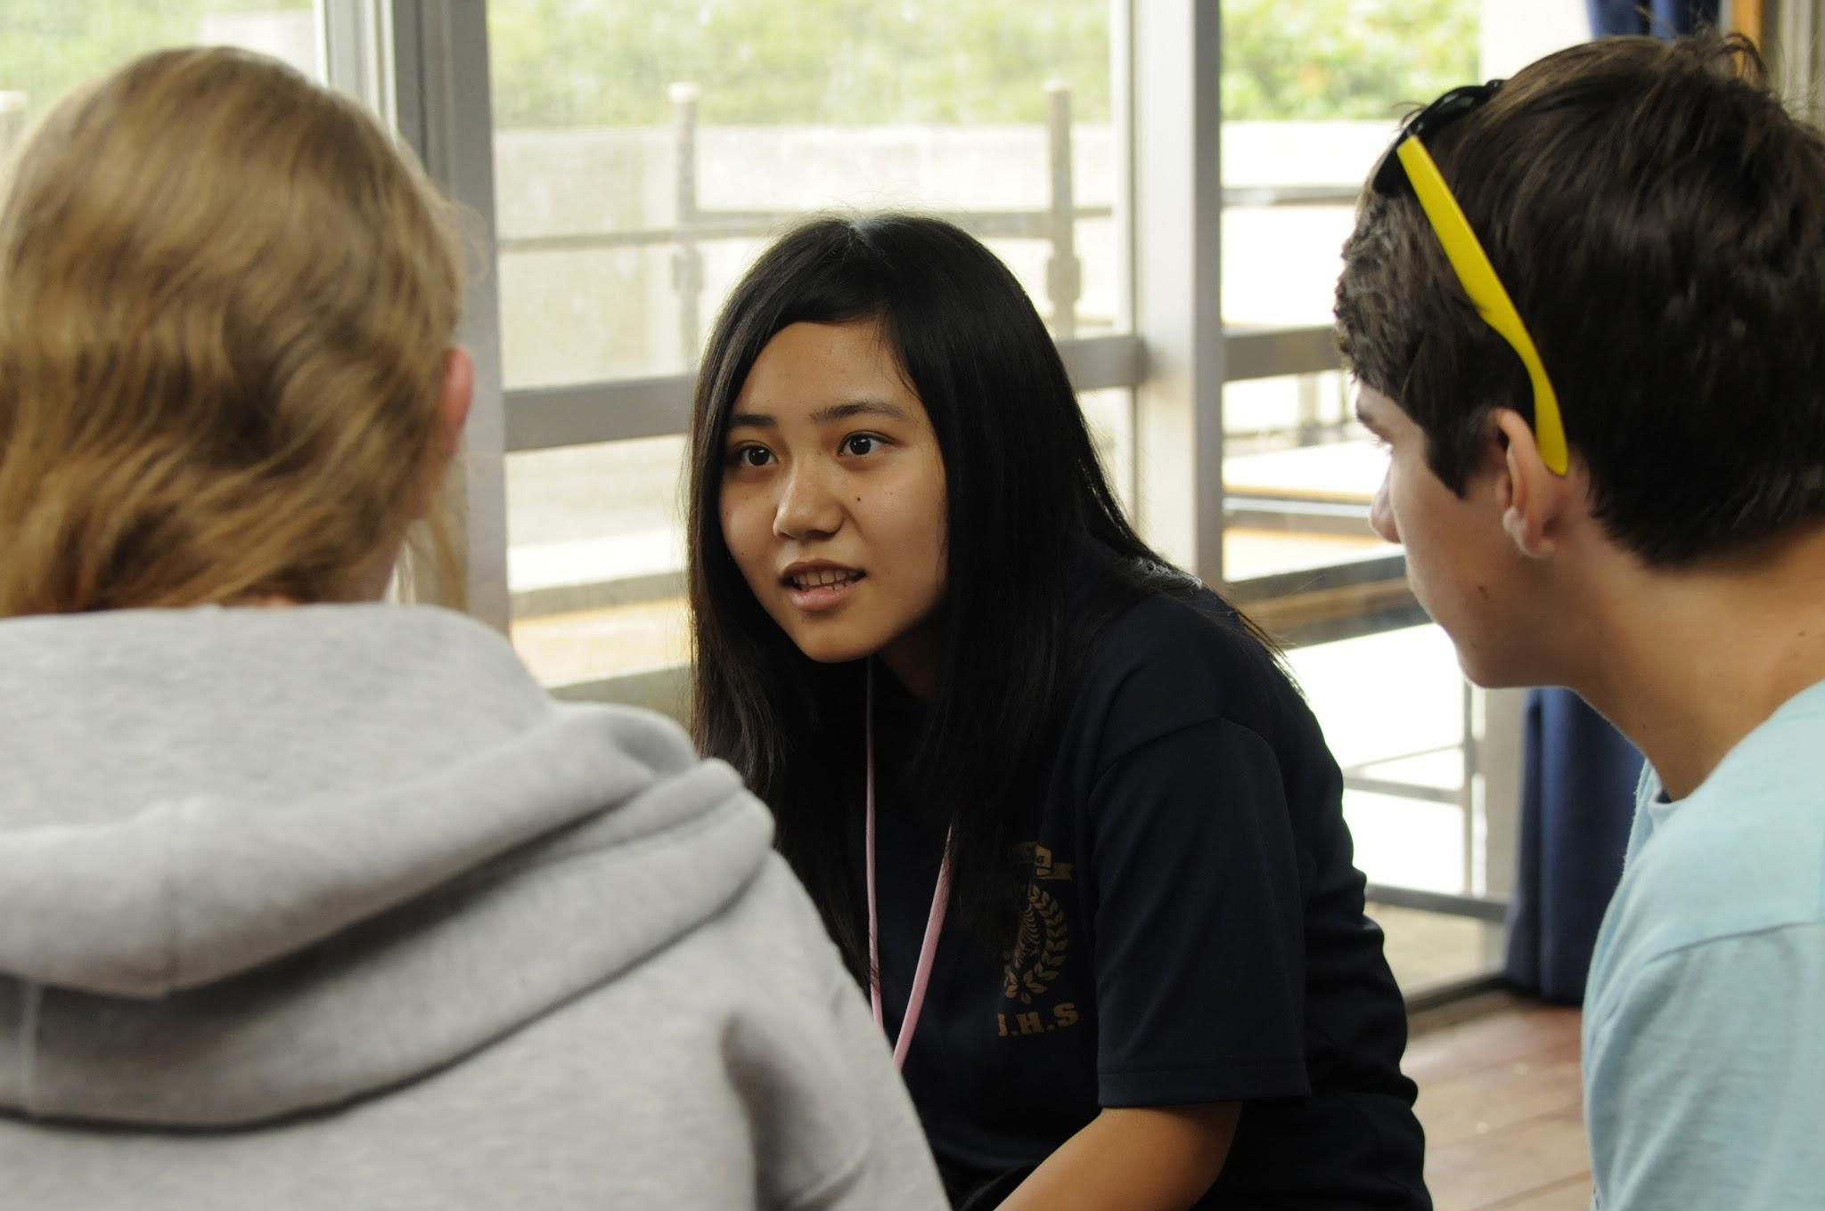
Learning About Teen Interests

Slide 32
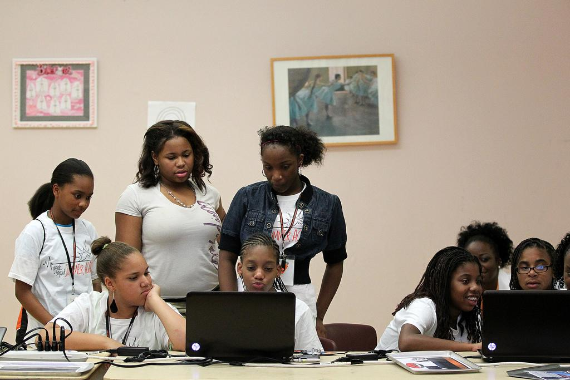
Leverage Teen Interests

Slide 33
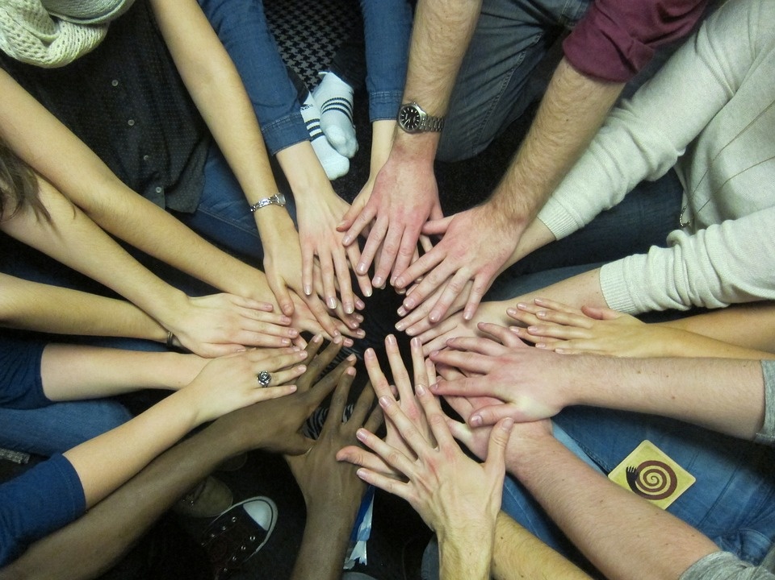
Build Community Relationships

Slide 34
Taking Action
Use the template provided to write steps you can take to move forward with ideas discussed today in your community. Consider:
What’s the best way to get started - what can I do first and what needs more time and planning?
Who should I talk with first
What needs to change in my own work
What needs to change in my colleagues’ work
What needs to change in the library overall
Who should I talk to about what I’ve learned
How will you begin to view success - outcomes vs. outputs

Slide 35
Learn More
Resources from the workshop available at: http://leonline.com/engaging-teens-with-your-library/
Contact me: lbraun@leonline.com

Slide 36
Close & Q&A

